Slide 1
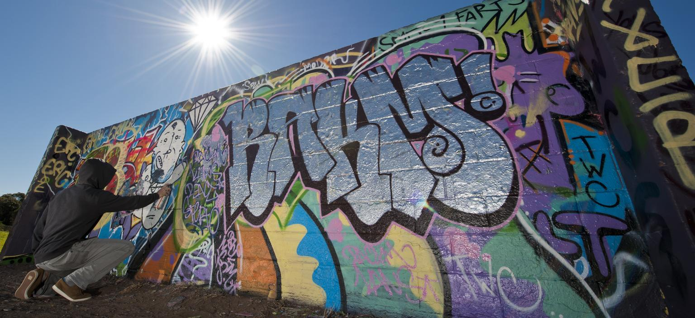
Graffiti Incident Tracking System
(GITS)
Team: Michael Jannain, Julian Nunez, Jose Garcia, Jimmy Doan

Slide 2

Roles
Michael - Project Manager / Software Manager
Julian - Configuration Manager
Jimmy - System Engineering Manager
Jose - Test Manager

Slide 3
What is GITS?
An integrated reporting system to aid the Central City police department in graffiti identification, classification, and tracking.

Slide 4
Major Capabilities for GITS
Internet portal that allows Public Works personnel to document & send graffiti incident data to investigating law enforcement officials.
User interface that allows investigating law enforcement officials to view, edit, and update the incident data, along with any photos of the damage and identity of graffiti suspects.
Analysis capabilities that will allow law enforcement officials to identify "hot spots".
Reporting capabilities that will allow authorized staff to request, view, and/or print reports based on information in the database.

Slide 5
System and Performance Requirements
User Interface Performance: fully graphical with multiple, moveable, and resizable windows. (5 second response time for transactions).
Operational Environment: Support Multiple Users in Web environment.
Security Access: Password protected accounts & access to only assigned cases.
Single Entry of Information
Validation of Inputs
Entry and Processing of Names
Online Help Function
Menu Driven System: Standardized movement from screen to screen without having to return to main menu.
Error Messages

Slide 6
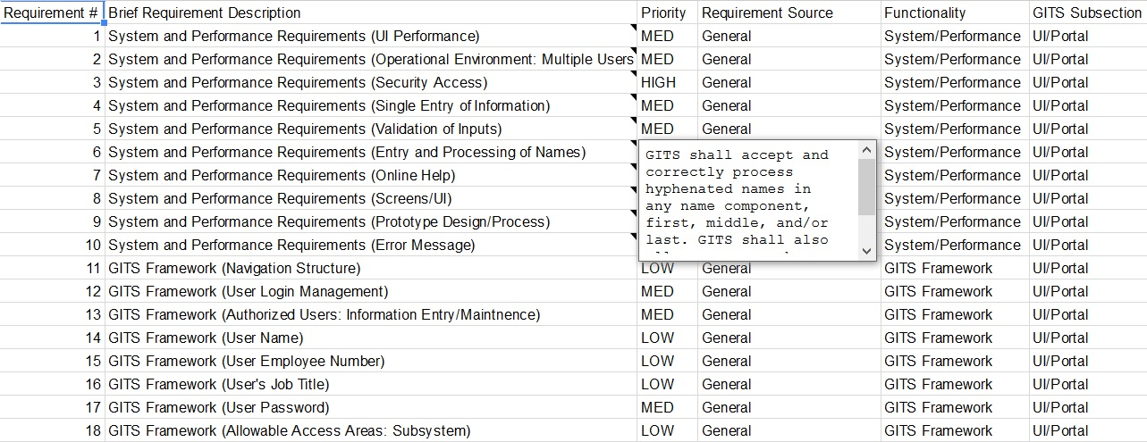
Requirements Database

Slide 7

Estimated Size (SLOC)
Estimate: 1,500 lines of code
Actual: 4,000 lines of code

Slide 8
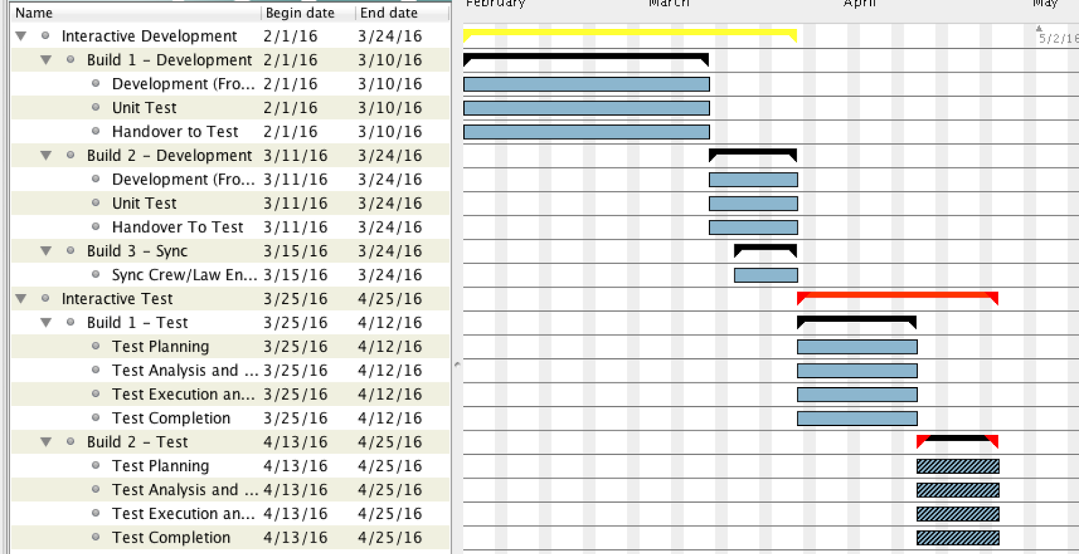
Estimated Schedule

Slide 9
Object Oriented Architecture
Each incident entry is an object with the following attributes:
Incident Record Information (Record ID & Date Created)
City Crew Info (Crew ID, Supervisor Name, Date on site, Scale of cleanup effort)
Graffiti Info
Type of building or structure
Street Address of building or property
GPS Coordinates
Moniker
Images
Suspect Info (Law Enforcement Officials)
Suspect name(s)
Suspect image
Gang or crew name
Status: unknown, identified, in custody, released

Slide 10
Tools/Languages Used
Google Drive (Documents, Sheets, and Slides)
Github
Python
Django
HTML
MySQL
SQLite3
TkInter

Slide 11
Increment 1
User Interface Performance: fully graphical with multiple, moveable, and resizable windows. (5 second response time for transactions).
Operational Environment: Support Multiple Users in Web environment.
Security Access: Password protected accounts & access to only assigned cases.
Single Entry of Information
Validation of Inputs
Entry and Processing of Names
Online Help Function
Menu Driven System: Standardized movement from screen to screen without having to return to main menu.
Error Messages

Slide 12
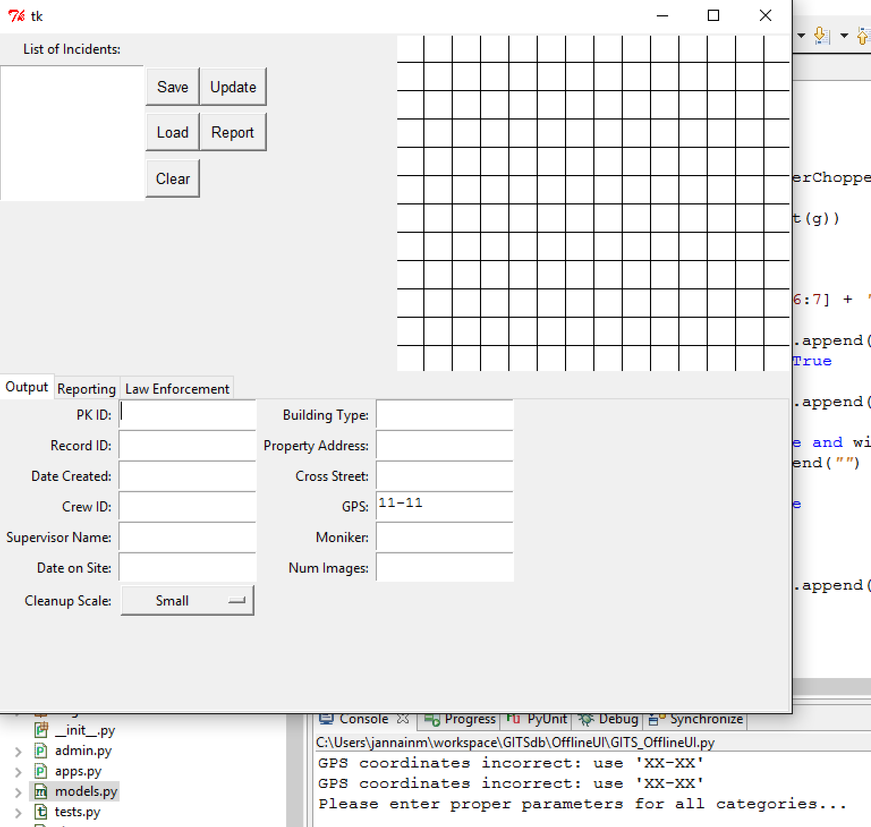
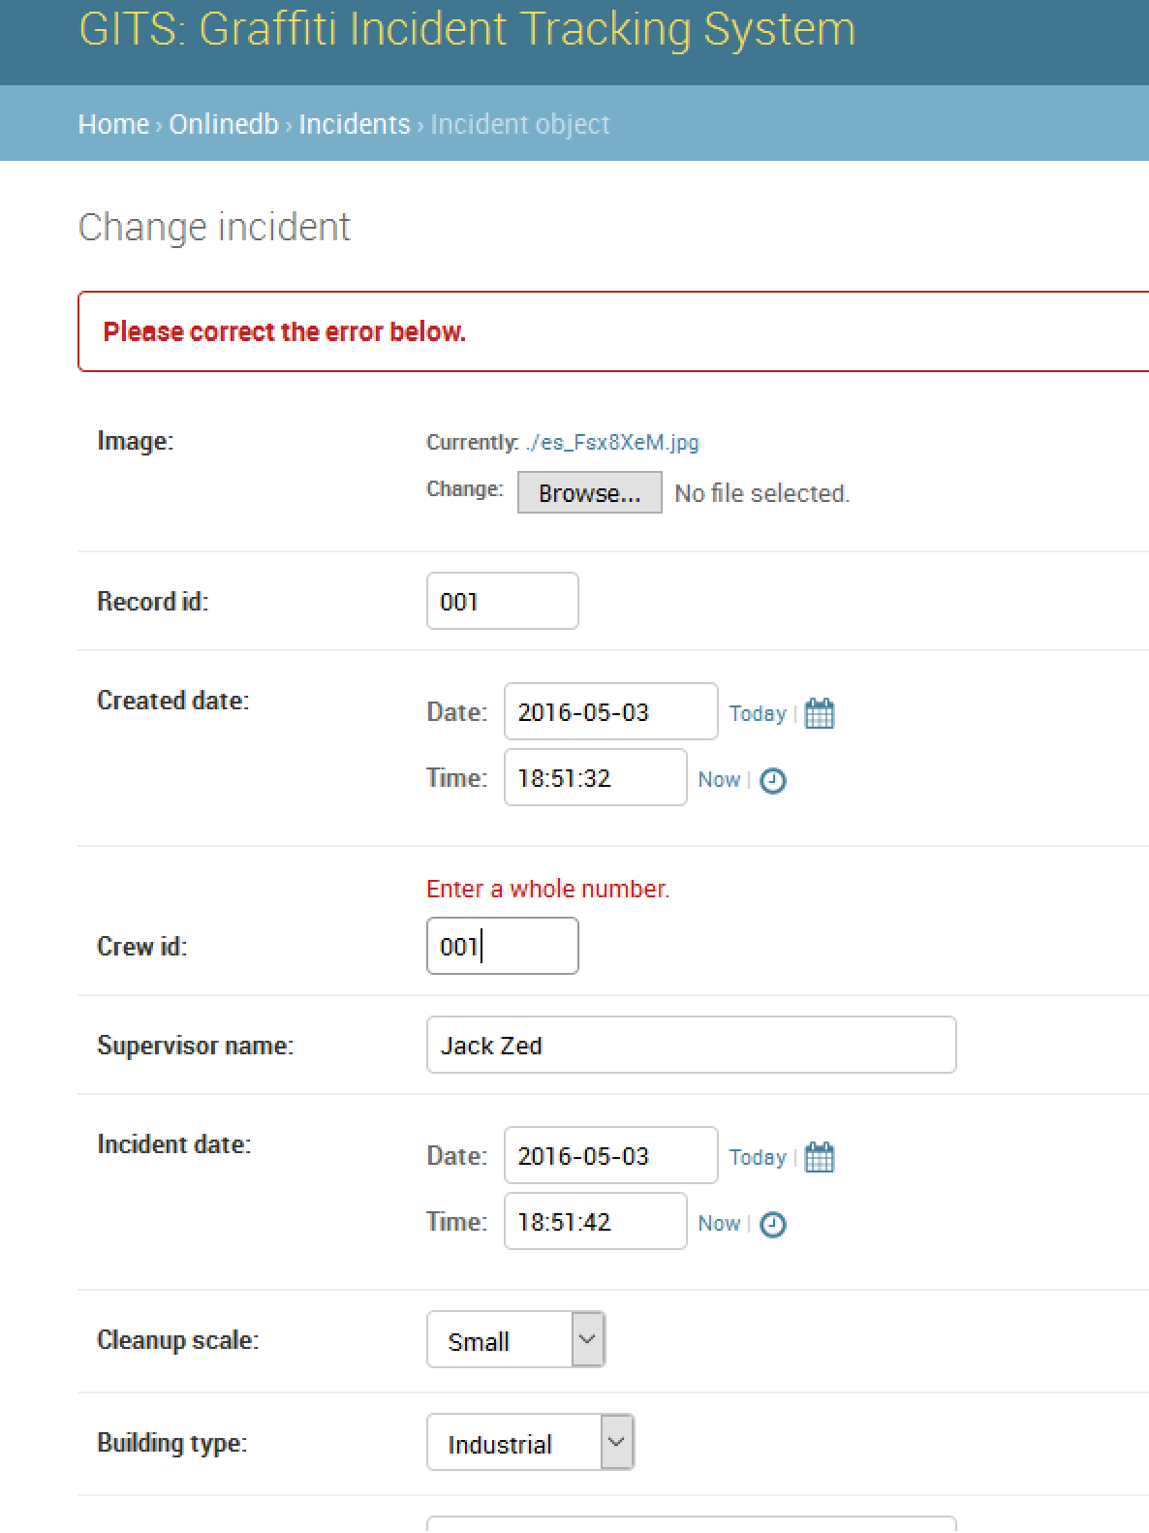
Testing

